Slide 1
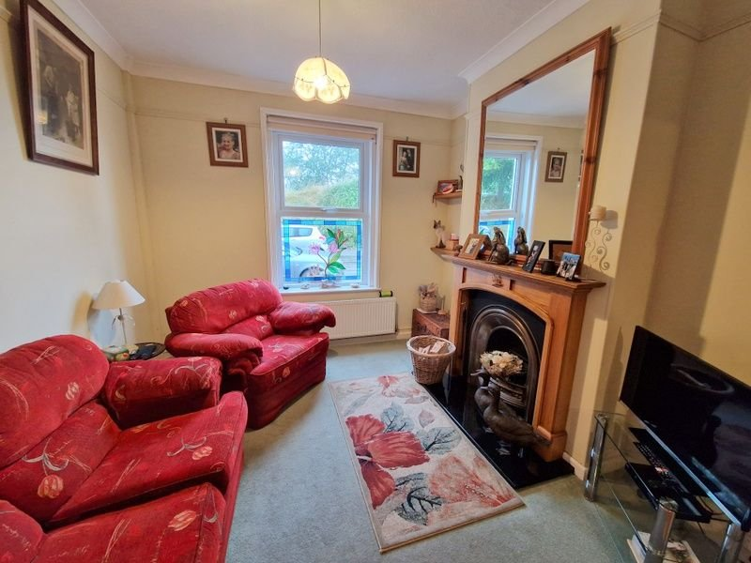
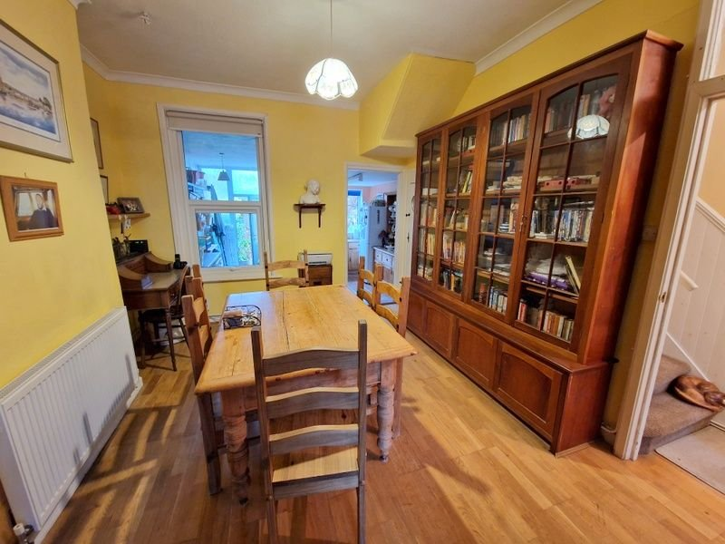
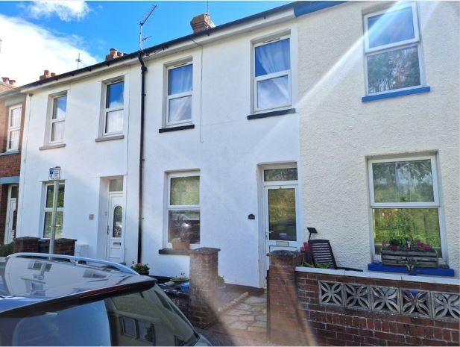
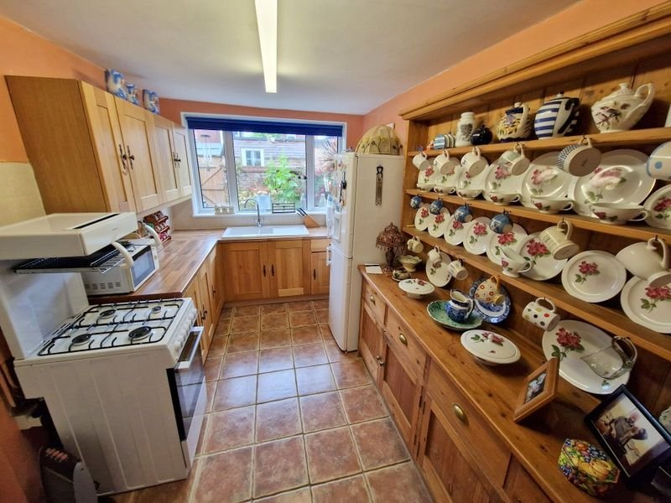
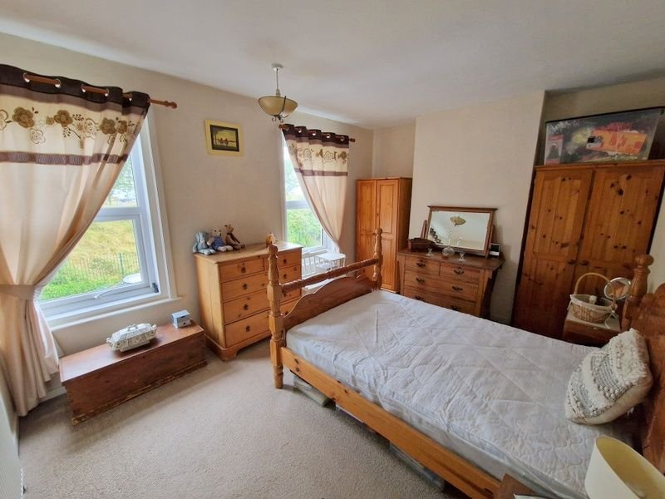
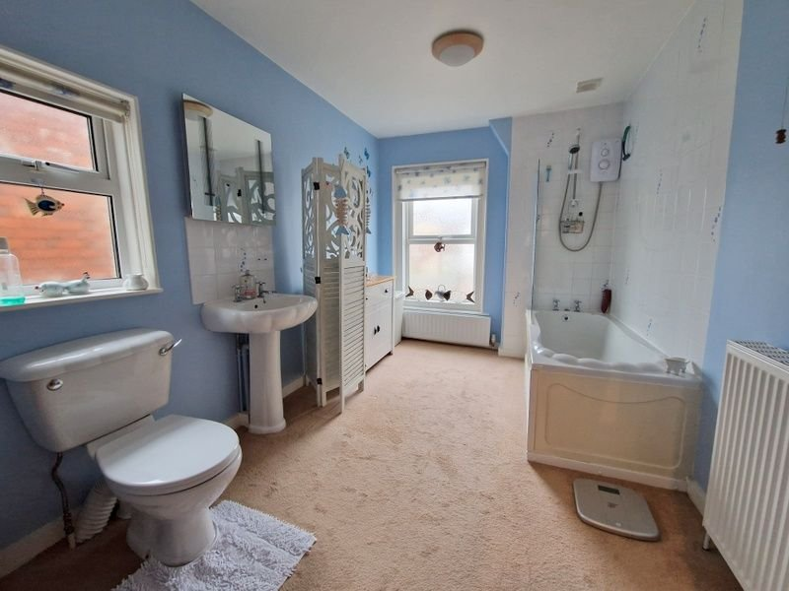
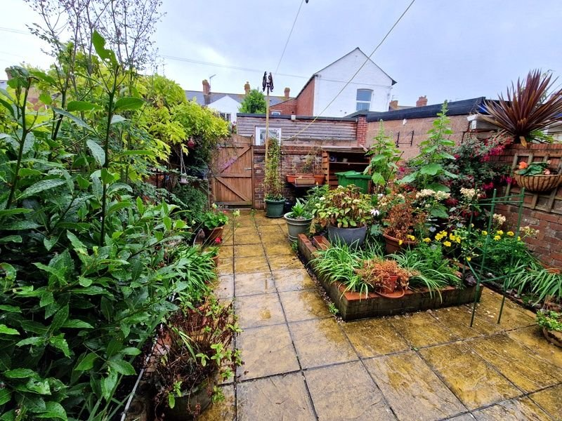
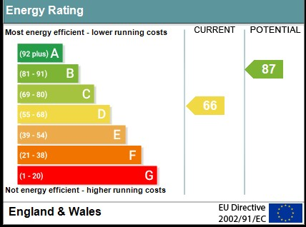
www.pennys.net
26 Halsdon Road, Exmouth, EX8 1SR
GUIDE PRICE £259,950
TENURE Freehold
A Well Presented And Maintained Mid Terrace House Conveniently Located Close To The Train Station And Town Centre With Outlook Towards The Estuary
Entrance Vestibule * Reception Hall * Through Lounge And Dining Room * Kitchen * Two First Floor Bedrooms * Spacious Bathroom Suite * Gas Central Heating * Upvc Double Glazed Windows * No Ongoing Chain
Pennys Estate Agents Limited for themselves and for the vendor of this property whose agents they are give notice that:- (1) These particulars do not constitute any part of an offer or a contract. (2) All statements contained in these particulars are made without responsibility on the part of Pennys Estate Agents Limited. (3) None of the statements contained in these particulars are to be relied upon as a statement or representation of fact. (4) Any intending purchaser must satisfy himself/herself by inspection or otherwise as to the correctness of each of the statements contained in these particulars. (5) The vendor does not make or give and neither do Pennys Estate Agents Limited nor any person in their employment has any authority to make or give any representation or warranty whatever in relation to this property.
PENNYS ESTATE AGENTS
2 Rolle House, Rolle Street, Exmouth, Devon, EX8 2SN
Tel: 01395 264111 EMail: help@pennys.net

Slide 2
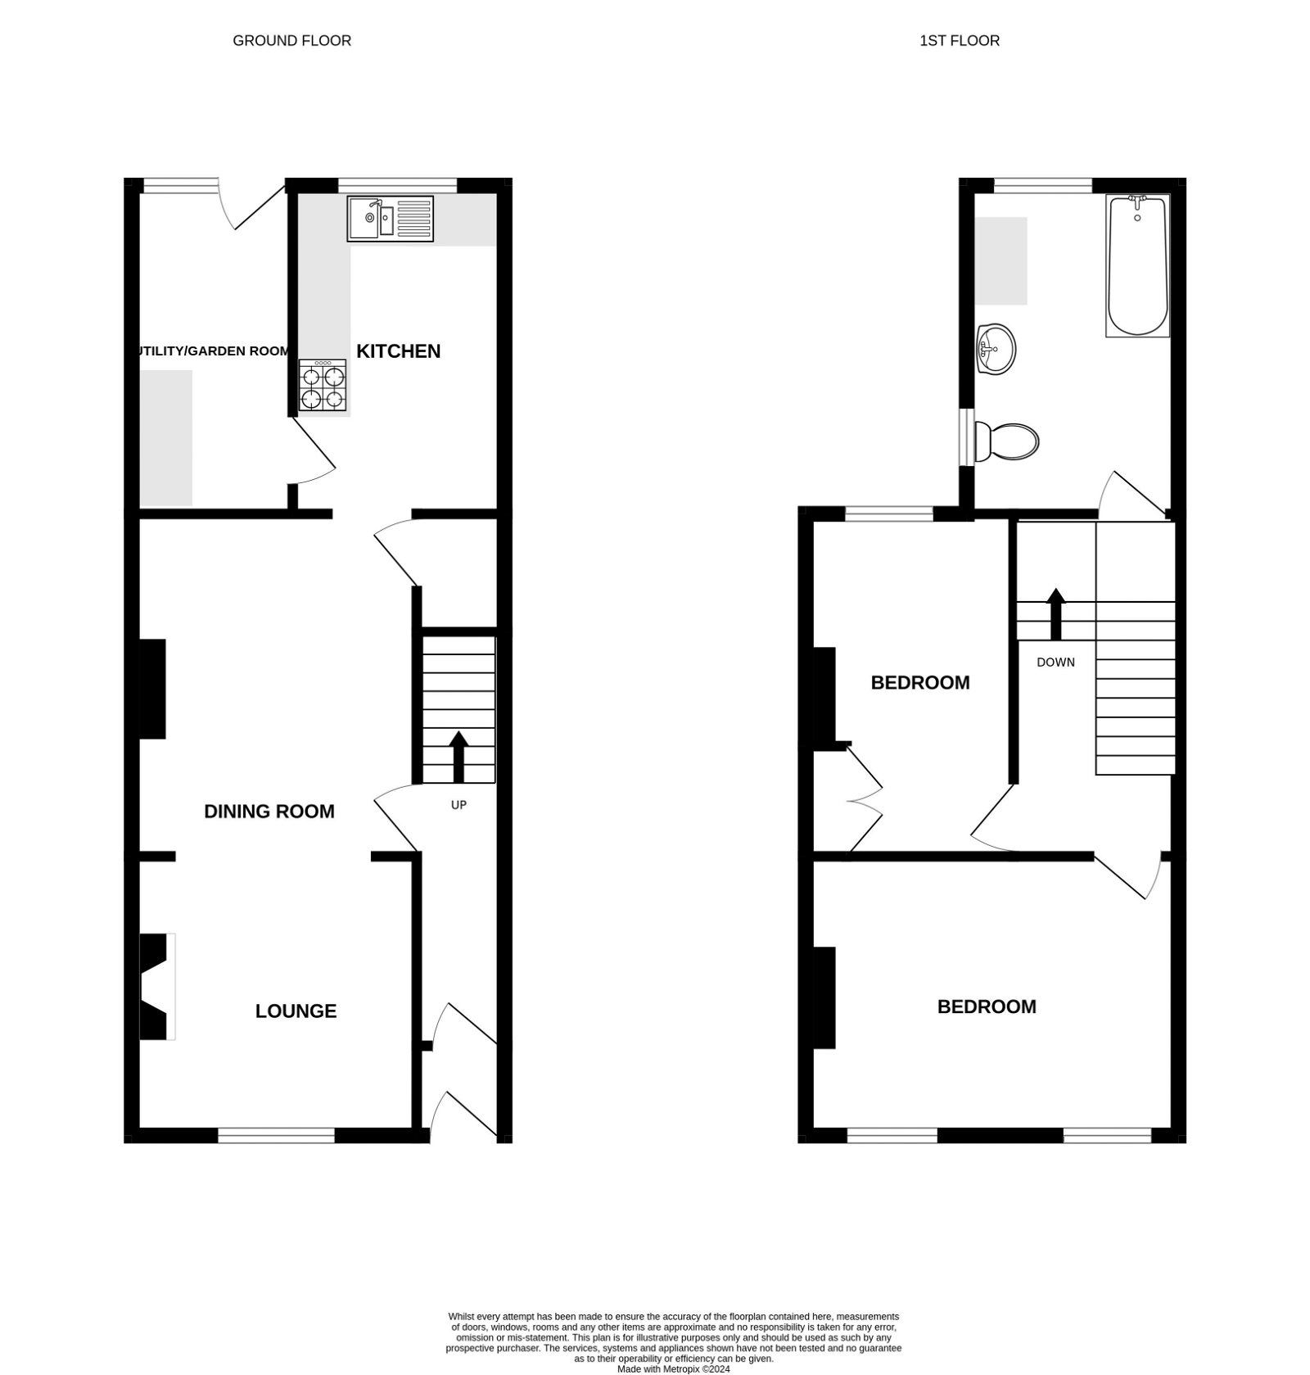
26 Halsdon Road, Exmouth, EX8 1SR
THE ACCOMMODATION COMPRISES: Double glazed front door with pattern window inset to:
ENTRANCE VESTIBULE: Wood flooring, inner door with patterned glass to:
RECEPTION HALL: Wood flooring, radiator, staircase rising to first floor landing, door to:
OPEN-PLAN LOUNGE AND DINING ROOM:
LOUNGE AREA: 3.15m x 3.25m (10'4" x 10'8") With attractive fire with wooden fire surround and grate with marble hearth, TV point, radiator, picture rail, coved ceiling and uPVC double glazed window to front aspect.
DINING ROOM: 3.96m x 3.45m (13'0" x 11'4") measurement into wall recess. With wood flooring, radiator, uPVC double glazed window to rear aspect, good size understairs storage cupboard and opening to:
KITCHEN: 3.86m x 2.41m (12'8" x 7'11") Fitted with wood effect worktops with ceramic one and a half bowl single drainer sink unit with chrome mixer tap with cupboards and drawer units beneath worktops in tiled surrounds, matching wall mounted cupboards, gas cooker point, space for upright fridge/freezer, tiled flooring, uPVC double glazed window to rear aspect, fitted upright storage cupboard, door with patterned glass inset to:
UTILITY/GARDEN ROOM: 3.94m x 1.52m (12'11" x 5'0") A useful area with wood effect worktops with plumbing for automatic washing machine and tumble dryer space beneath, power and light connected, uPVC double glazed window with patterned glass and uPVC double glazed door also with patterned glass giving access to the rear garden.
FIRST FLOOR SPLIT LEVEL LANDING: Access to roof space.
BEDROOM 1: 4.37m into wall recess x 3.23m (14'4" x 10'7") A spacious main bedroom with two sets of uPVC double glazed windows to front elevation enjoying an outlook towards the estuary and coastline beyond, radiator.
BEDROOM 2: 3.94m x 2.57m (12'11" x 8'5") With fitted linen cupboard in wall recess housing Worcester gas boiler for hot water and central heating, radiator, uPVC double glazed window to rear aspect.
BATHROOM/WC: 3.86m x 2.39m (12'8" x 7'10") Extremely spacious bathroom fitted with bath with Mira shower unit over and shower splash screen with tiling to splash prone areas, pedestal wash hand basin with matching tiled splashback and fitted mirror with integrated light over, WC, radiator, uPVC double glazed window with patterned glass.
OUTSIDE: To the rear of the property is an attractive enclosed garden planned with ease of maintenance with patio sun terrace, raised well stocked flower and shrub beds, pedestrian gate to rear service lane.
FLOOR PLAN:

